Slide 1
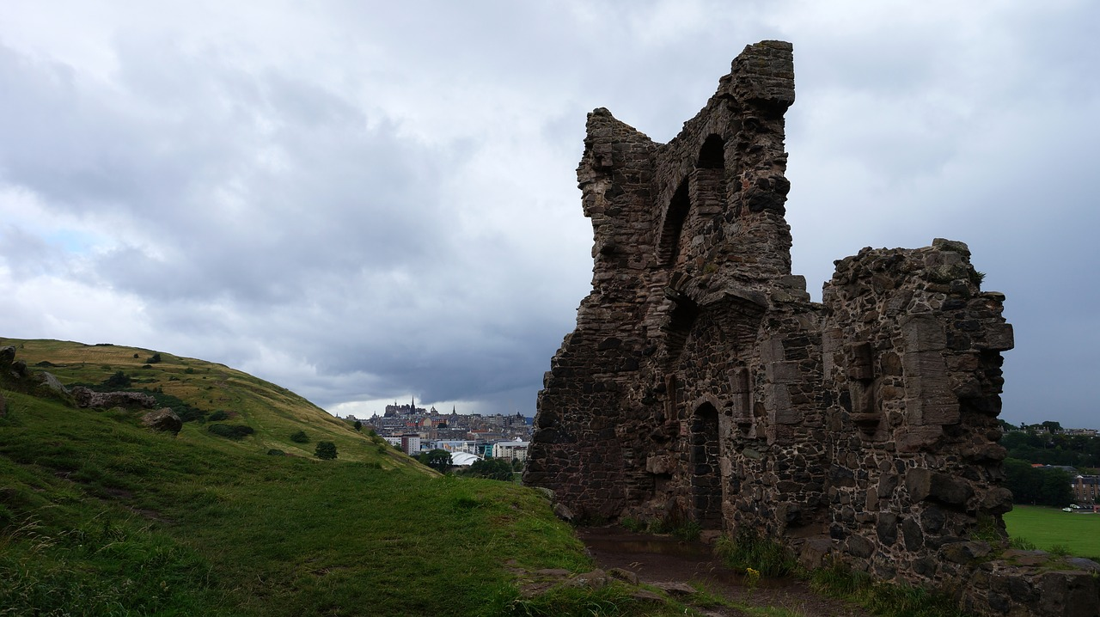
Devolve

Slide 2



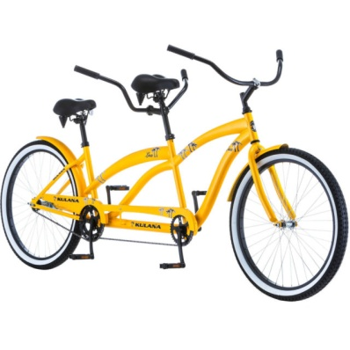
Mechanic
Setting yourself or your enemy to an earlier state, to achieve the objective
Smaller
devolve
Slower
devolve

Slide 3





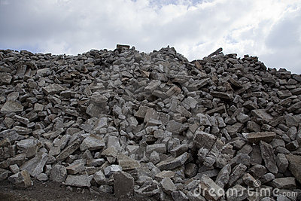
Less cover
Possible escape
Provides projectiles

